Slide 1
Computer Systems
Exercise 6

Slide 2
REMINDER: Exam question
vs
My email: schwabea@ethz.ch
https://hanslodge.com/clipart/8Txr4xdoc.htm
http://clipartmag.com/angel-cartoon-clipart

Slide 3
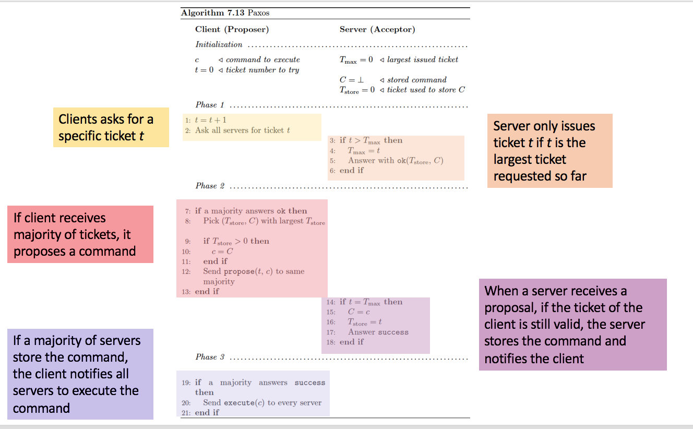
Last last exercise
Example where Paxos does not terminate does not work if same ticket numer! But with ticket A = ticket B -1 it works!
A
N1
N2
N3
B
T = 0
T = 1
ok
ok
T = 2
Propose 1
ok
success
Propose 2
T = 3
success
ok
T = 4
Propose 3
ok
success
Propose 4
T = 5
success
ok

Slide 4
Last Exercise
What is the problem with shortest job first (SJF)?
Answer: Long jobs are potentially never scheduled
What is the advantage of shortest job first (SJF)?
Answer: It minimizes the average time a task is waiting to be scheduled (and therefore the average turnaround time)
What is the benefit of round robin(RR)?
Answer: It has a good response time. (And is easy to implement/understand/analyze)
What is the big conceptual difference between earliest deadline first (EDF) and round robin (RR)?
Answer: EDF is for realtime workloads, so tasks have priorities. RR treats all tasks the same.

Slide 5
Last exercise
Why do hard realtime systems often don’t have dynamic scheduling?
Answer: In a dynamic setup, the feasibility of a correct schedule is often not guaranteed -> we don’t want that for hard realtime systems.
What algorithm would be good for interactive workloads?
Round robin (RR), because it has the best response time.
What is priority inversion?
Answer: A lower priority task is running and holding a lock for A, it gets preempted by a higher priority task which can’t proceed because the lower priority thread is still holding the lock and gives up the scheduler to a medium priority thread.

Slide 6
Priority Inversion
Can not take Mutex → blocks and allows other T2 to run
T3
Preemption
Priority
T2
Takes Mutex
T1
Time

Slide 7
Last exercise
What is the problem with priority inversion?
Answer: High-priority tasks cannot proceed because low-priority tasks are running.
What preconditions must hold to achieve priority inversion?
Answer: There must be at least three runnable tasks of different priorities. The lowest one must hold a lock that the highest one needs to proceed.
How can this problem be solved?
Answer: This can be solved by the priority inheritance scheme. The task holding the lock temporarily inherits the priority of the task which wants to acquire the lock.

Slide 8
Last exercise
How many levels of priority inheritance do you need?
You need as many levels as possible priority levels.
Why?
Because the low priority thread has to inherit the priority of the high priority thread that wants to acquire the priority.
How could you implement that?
Problem: A low priority thread holding multiple locks that multiple high priority tasks want. So after releasing one lock and one high priority task running, the priority shouldn’t be reset to the original level, but to the one of the other thread needing the lock.
Solution: A linked list of priorities that the thread will get reset to.

Slide 9
Last exercise
State three advantages/disadvantages of placing functionality in the device controller (hardware), rather than in the kernel (software)?
Advantages:
Bugs are less likely to cause an operating system crash
Performance can be improved by utilizing dedicated hardware and hard-coded algorithms
The kernel is simplified by moving algorithms out of it
Disadvantages
Bugs are harder to fix- a new firmware version or new hardware is needed
Improving algorithms likewise require hardware update rather than just a kernel or device driver update
Embedded algorithms could conflict with application’s use of the device, causing decreased performance

Slide 10
Last exercise
Why might a system use interrupt-driven I/O to manage a single serial port( character device), but polling I/O to manage a front-end processor, such a terminal concentrator?
Polling can be more efficient than interrupt-driven I/O when I/O is frequent and of short duration.
Describe a hybrid strategy that combines polling, sleeping and interrupts for I/O device service. For each of these three strategies (polling, interrupts, hybrid), describe a computing environment in which that strategy is more efficient than is either of the others.
Hybrid approach: Switch between polling and interrupts depending on the length of the I/O operation wait. Eg. Loop N times and if device is still busy at n+1, go to sleep. This approach is good for very long or very short busy times
Pure polling is best with very short wait times
Pure interrupts is best with long wait times

Slide 11
Last exercise
How does DMA increase system concurrency? How does it complicate the hardware design?
DMA increases system concurrency by allowing the CPU to perform tasks while the DMA system transfers data via the system and memory buses.
Hardware design is complicated because the DMA controller must be integrated into the system and the system must allow the DMA controller to be a bus master.
Although DMA does not use the CPU, the maximum transfer rate is still limited. Consider reading a block from disk. Name three factors that might ultimately limit the file transfer.
Limited speed of the I/O device
Limited speed of the bus
A disk controller with no internal buffers or too small buffer size could also limit the performance of the read file operation

Slide 12
Last exercise
A DMA controller has multiple channels that can be used by device drivers to request a DMA transfer. The controller itself is capable of requesting a 32 bit word ever 100 nsec. A response takes equally long. How fast does the bus have to be to avoid being a bottleneck?
Every bus transaction has a request and a response each taking 100 nsec, or 200 nsec per bus transaction. This gives 5 million bus transactions/sec. If each one is four bytes, the bus should be able to handle 20MB/sec. The fact that these transmissions may be distributed over multiple I/O devices in round-robin fashion is irrelevant. A bus transaction takes 200 nsec, regardless of whether consecutive requests are to the same device or different device, so the number of channels the DMA controller has does not matter.

Slide 13
Byzantine nodes
Node which has arbitrary behavior
So it can:
Decide not to send messages
Sending different messages to different nodes
Sending wrong messages
Lie about input value
If an algorithm works with f byzantine nodes, it is f-resilient

Slide 14
Different Validities
Any-input validity:
The decision value must be input of any node
That includes byzantine nodes, might not make sense
Correct-input validity:
The decision value must be input of a correct node
Difficult because byzantine node could behave like normal one just with different value
All-same validity:
if all correct nodes start with the same value, the decision must be that value
Median validity:
If input values are orderable, byzantine outliers can be prevented by agreeing on a value close to the median value of the correct nodes

Slide 15
Byzantine agreement in the synchronous model
Assumption: nodes operate in synchronous rounds. In each round, each node may send a message to each other node, receive the message by other nodes and do some computation.
-> runtime is easy, since it is only the number of rounds

Slide 16
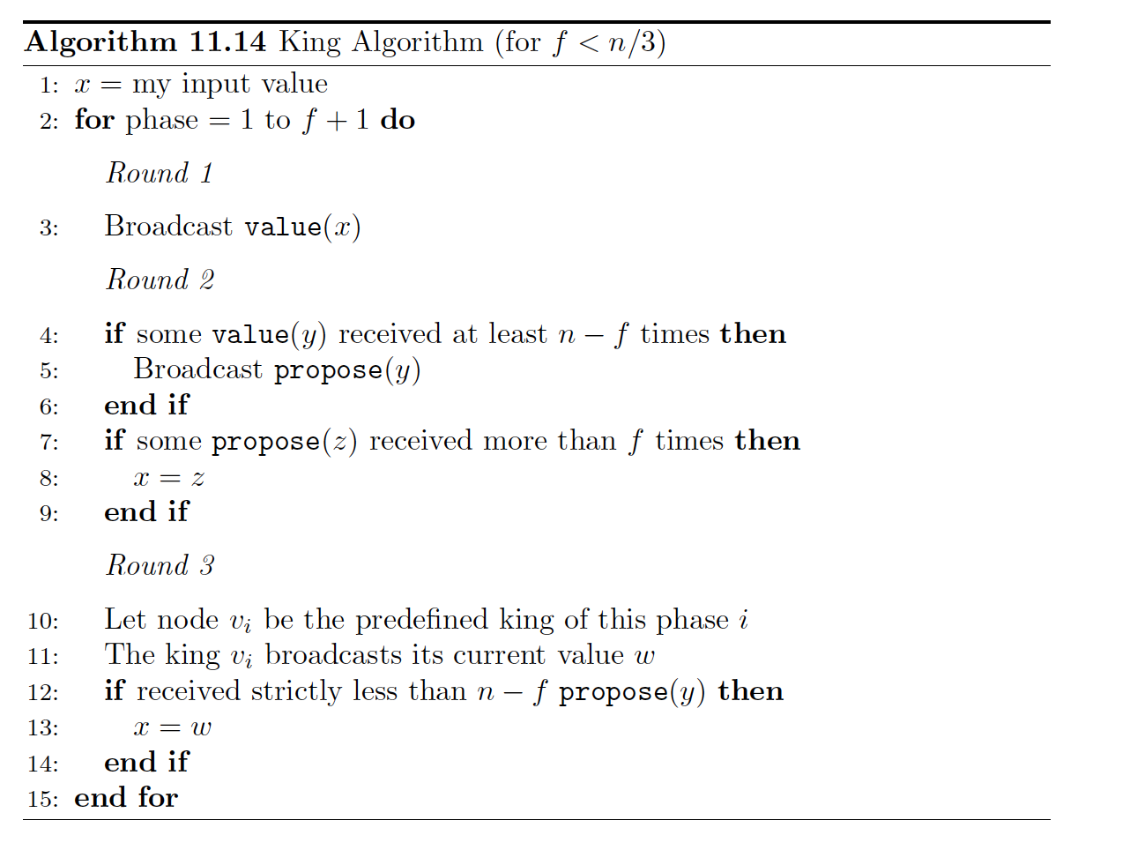
King Algorithm (synchronous byzantine agreement)
Do until at least one correct input node
Idea:
If not all correct input nodes have the same value, decide on value of one correct input node. Ensure this by doing f+1 rounds, since there must be at least one correct input node.
Send out own value
If some value received from
all nodes but byzantine ones (or at least
((n – f)- f) correct ones), propose that
value
If some value proposed by at
least one correct node,
set your value to that value
King of this phase broadcasts
its value
If didn’t get propose from all nodes
but byzantine ones (or at least
((n – f)- f) correct ones),
set your value to value of king

Slide 17
King Algorithm (synchronous byzantine agreement)
Why f+1?
Because there are f byzantine nodes, at least one of the kings will be a correct node

Slide 18
King Algorithm (synchronous byzantine agreement)

Slide 19
King Algorithm (synchronous byzantine agreement)
Why n-f?
Because if there are n-f correct nodes, so we can’t wait for more. If we wait for less than f + 1 nodes, all the input values could be fake. Because 3f < n, n – f > f.
Ensures only one proposal: If one node sees n-f values v, then every other node sees at least n-2f times v. Because n- (n-2f) = 2f < n-f, there can be no proposal for another value.
All same validity ensured here!

Slide 20
King Algorithm (synchronous byzantine agreement)
Why more than f?
If we just waited for <= f propose messages, they all could be byzantine.

Slide 21
King Algorithm (synchronous byzantine agreement)
Why n-f propose messages?
Similar as for n-f broadcast messages. We can wait for at most n-f ones because those are the correct nodes, and we have to wait for at least f+1 ones.
After a correct king, the correct nodes will not change their values anymore! Why?
If all of them have less than n-f propose messages, all correct nodes will have the king value and then “all same validity” holds. If one does not adapt, this means that it got n-f propose messages. This means, every other message got at least n-f-f > f propose messages, so it adapted its value to the propose. So the king also adapted it’s value and again all nodes have the same value.

Slide 22
King Algorithm (synchronous byzantine agreement)
Does it solve byzantine agreement?
Validity: All same validity!
Agreement: They agree at least after
the first correct king.
Termination: After (f+1)*3 rounds

Slide 23
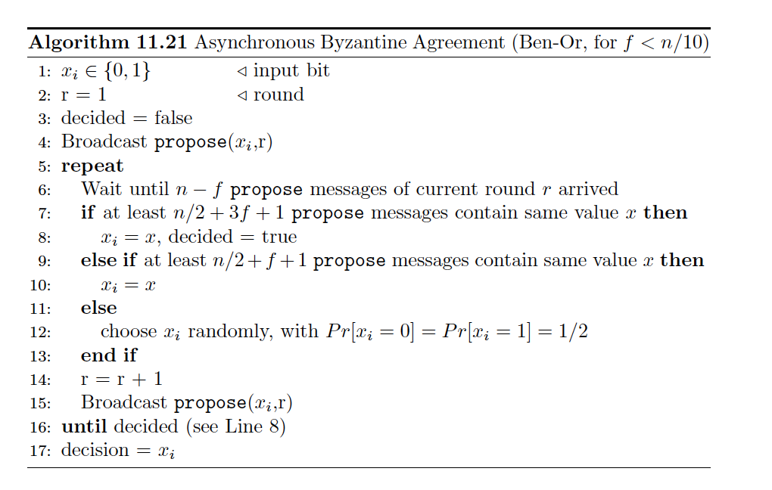
Asynchronous Byzantine Agreement
Assumption: Messages do not need to arrive at the same time anymore. They have variable delays.
-> Also works, but is a lot more complicated.
-> Algorithm in script is proof of concept, so don’t worry about it too much.
->Asynchronity changes messages you have to wait for, but not principle
Problem: slow! (exponential runtime)
Broadcast own value
Do until converged
Wait for enough messages
If big enough amount agrees, decide and terminate
If some agree, adapt your value but don’t decide yet
If no popular value, decide randomly
Broadcast own value

Slide 24
Asynchronous Byzantine Agreement with oracle
Now, if no popular value, all correct nodes will decide on same oracle value.
Constant runtime
Problem: oracle does not exist
Broadcast own value
Do until converged
Wait for enough messages
If big enough amount agrees, decide and terminate
If some agree, adapt your value but don’t decide yet
If no popular value, ask oracle
Broadcast own value

Slide 25
Asynchronous Byzantine Agreement with random bitstring
New idea: generate a random bitstring and take next value of bitstring instead of asking oracle
Problem: byzantine nodes know “random” value and can adapt their behavior
Broadcast own value
Do until converged
Wait for enough messages
If big enough amount agrees, decide and terminate
If some agree, adapt your value but don’t decide yet
If no popular value, ask look at bitstring
Broadcast own value

Slide 26
Asynchronous Byzantine Agreement with blackboard
Back to the roots! – shared coin
Implement it by writing values to a public blackboard, after seeing a certain amount of values nodes decide on coin value
Constant probability that value is the same for all
Similar to shared coin but works asynchronously
Byzantine nodes don’t know value of shared coin in advance
Broadcast own value
Do until converged
Wait for enough messages
If big enough amount agrees, decide and terminate
If some agree, adapt your value but don’t decide yet
If no popular value, generate shared coin
Broadcast own value

Slide 27
Reliable Broadcast
Best effort broadcast
Best effort broadcast ensures that a message that is sent from a correct node v to another correct node w will be received and accepted by w
Reliable broadcast
Reliable broadcast ensures that the nodes eventually agree on all accepted messages. That is, if a correct node v considers message m as accepted, then every other node will eventually consider message m as accepted.
FIFO (reliable) broadcast
The FIFO (reliable) broadcast defines an order in which the messages are accepted in the system. If a node u broadcasts message m1 before m2, then any node v will accept the message m1 first.
Atomic broadcast
Atomic broadcast makes sure that all messages are always received in the same order. So for two random nodes u1 and u2 and two random messages m1 and m2, if u1 sees m1 first, u2 will also see m1 first.

Slide 28
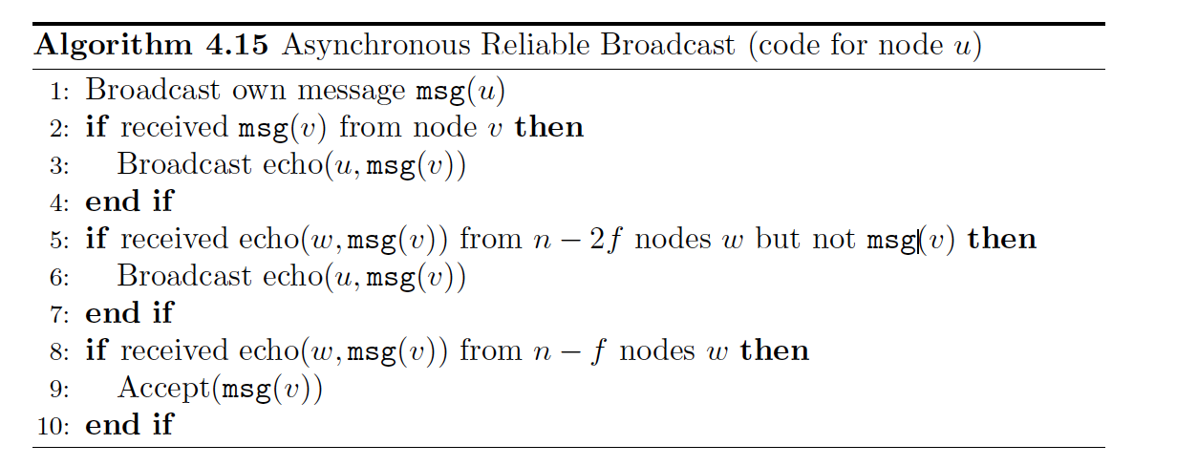
Reliable Broadcast
Broadcast own value
If message received from node directly, broadcast it together with your own name
If you do not get message from node directly, but from a reasonable amount of others also broadcast with own name
If you get enough forwarded messages, accept message

Slide 29
Reliable Broadcast
Guarantees:
If a node broadcasts a message reliably, all correct nodes will eventually accept that value
If a correct node has not broadcast a message, it will not be accepted by any other correct node
If a correct node accepts a message from a (byzantine) node, it will be eventually accepted by every correct node
Problem:
Does not terminate!
Does only tolerate <= n/5 byzantine nodes
This is better if we use the FIFO assumption

Slide 30
Quiz
Can byzantine nodes collaborate?
Yes
Can byzantine nodes forge a sender address?
No, otherwise one could impersonate all correct ones.
In all-same validity, is the decision value restricted if not all nodes start with the same value?
No
Can there be any algorithm that can solve synchronous byzantine agreement in less than f+1 rounds?
No, because the node with the smallest value can propagate its value to one further node and then crash f times. So in the last round, one node knows about the new value but has no chance to propagate it.

Slide 31
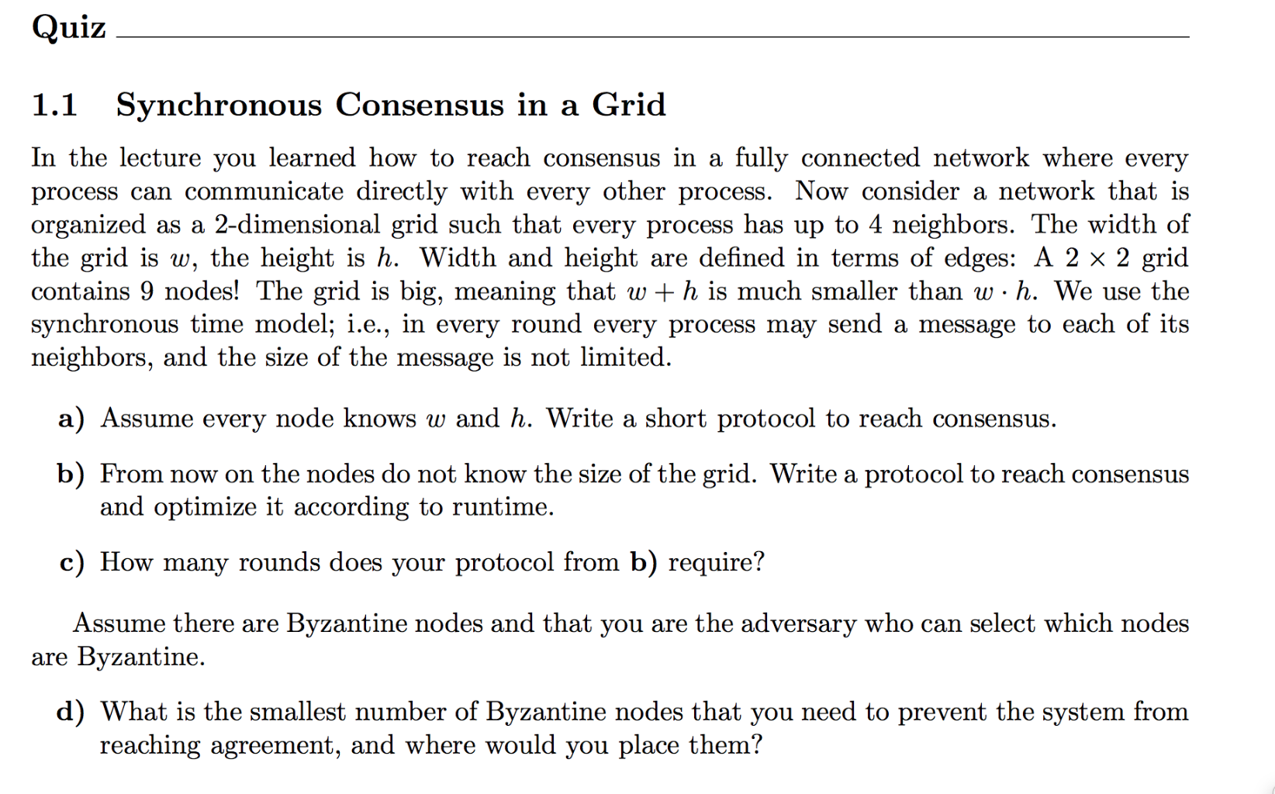

Slide 32
